Slide 1
Lesson 01 Arithmetic and Geometric Sequences
Interactive Seminar Slides
E114 – Mathematics for Engineering

Slide 2


Scenario
Jack and Jill were interested to get the latest Apple Mac Pro which cost around $4500.
As they had just started work and had no savings, they individually decided to save part of their salary on a monthly basis in order to purchase the item. They have different saving plans.
Determine who would be able to purchase the item first.
Picture taken from: https://www.apple.com/sg/shop/buy-mac/mac-pro

Slide 3

Scenario
Jack’s saving plan:
Start with $100 in the end of first month.
Increase the previous monthly saving by $6 every month.
Jill’s saving plan:
Also, start with $100 in end of first month.
Increase the previous monthly saving by 3% every month.
1st: $100
2nd: $100 + $6
3rd: $100 + $6 + $6
1st: $100
2nd: $100(1+3%)
3rd: $100(1+3%) (1+3%)

Slide 4
Scenario Definition Template
What We Know:
.
What We Don’t Know:
What We Need to Find Out:

Slide 5
Lesson Overview
S/N | Concepts | Slide Number
1 | Sequences and Series | 6
2 | Terms and sum of a sequence | 7
3 | Arithmetic sequence
i. | Definition | 8-9
ii. | nth term of an arithmetic sequence | 10-13
iii. | Sum of the first n terms of an arithmetic sequence | 14-19
4 | Geometric sequence
i. | Definition | 21-22
ii. | nth term of a geometric sequence | 23-26
iii. | Sum of the first n terms of a geometric sequence | 27-31
iv. | Sum to infinity of an infinite geometric sequence | 32-35
5 | Applications (CL) | 36-38

Slide 6
Sequences and Series
A sequence is a set of numbers arranged in a defined order, with a rule for obtaining the numbers.
A series is the sum of the terms in a sequence.
Both sequence and series can be finite or infinite.
[Example]
The following are examples of sequences and series:
1, 2, 3, 4, 5,…
9, 16, 25, 36, 49,…, 400
10 + 8 + 6 + 4 +2 +…
0, 1, 1, 2, 3, 5, 8,…
→+1 (infinite sequence)
Can you identify the rule for each sequence?
→n² (finite sequence)
→–2 (infinite series)
→÷2 (infinite sequence)
→(infinite Fibonacci sequence)

Slide 7
Terms and Sum of Sequence
For any sequence :
T_{n} denotes the nth term of a sequence.
Hence, T₁ represents the 1st term,
T₂ represents the 2nd term,
T₃ represents the 3rd term and so on.
S_{n} denotes the sum of the first n terms of the sequence, i.e.
and so on…
Useful result:

Slide 8
Arithmetic Sequences - Definition
An arithmetic sequence is a sequence of numbers in which each term (other than the first term) is obtained from its previous term by adding a constant, called the common difference.
Thus, an arithmetic sequence is of the form:
where a = first term
d = common difference
[Example]
The following are examples of arithmetic sequences:
1, 3, 5, 7, 9, …
5, 2, –1, – 4, …, – 52
Infinite arithmetic sequence.
First term, a = 1
Common difference, d = T₂ – T₁ = 2
Finite arithmetic sequence.
First term, a = 5
Common difference, d = T₂ – T₁ = –3

Slide 9

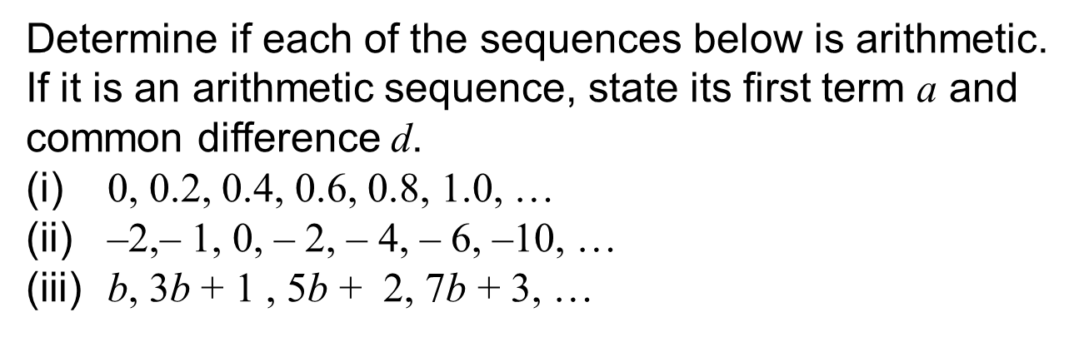
Test Yourself
Determine if each of the sequences below is arithmetic. If it is an arithmetic sequence, state its first term a and common difference d.
0, 0.2, 0.4, 0.6, 0.8, 1.0, …
–2,– 1, 0, – 2, – 4, – 6, –10, …
b, 3b + 1 , 5b + 2, 7b + 3, …

Slide 10
Arithmetic Sequences - nth term
Consider an arithmetic sequence of the form:
where a = first term
d = common difference
The nth term of the arithmetic sequence is given by
[Proof]
Let a general arithmetic sequence be
T₁ = a = a + 0d
T₂ = a + d = a + 1d
T₃ = a + 2d
T₄ = a + 3d
Therefore

Slide 11
Arithmetic Sequences - nth term
[Example] Write down the first five terms of the arithmetic sequence with first term 2 and common difference 5. Determine the 10th term, T₁₀.
[Solution]
a = 2, d = 5
The first five terms of the arithmetic sequence are:
2, 7, 12, 17, 22.
10th term,
Correct?

Slide 12

Test yourself
The first term of an arithmetic sequence is 5 and the sixth term is 40. Find the 717th term of the sequence.

Slide 13
Think-pair-share
Given that an arithmetic sequence has first term a = 60, common difference d = –3 and T_{n} term = 6. Find the number of terms, n, of this arithmetic sequence.

Slide 14
Arithmetic Sequences – Sum of the first n terms
Consider an arithmetic sequence of the form:
where a = first term
d = common difference
T_{n} = nth term
The sum of the first n terms of the arithmetic sequence is given by

Slide 15
Arithmetic Sequences – Sum of the first n terms
[Proof]
Let a general arithmetic sequence containing n terms be given by
Let S_{n} denote the sum of the first n terms of the arithmetic sequence.
We have Equation (1):
Rearranging, we can obtain Equation (2) below:
S_{n} = | a | + (a + d) | … | + [a + (n –2)d] | + [a + (n –1)d]
S_{n} = | [a + (n –1)d] | $$\text{+ [}\text{a}\text{ + (}\text{n}\text{ –2)}\text{d}\text{]}$$ | … | + (a + d) | + a

Slide 16
Arithmetic Sequences – Sum of the first n terms
Adding Equations (1) and (2):
S_{n} = | a | + (a + d) | … | + [a + (n –2)d] | + [a + (n –1)d]
+
S_{n} = | [a + (n –1)d] | $$\text{+ [}\text{a}\text{ + (}\text{n}\text{ –2)}\text{d}\text{]}$$ | … | + (a + d) | + a
2 S_{n} =
[2a + (n – 1)d]
[2a + (n – 1)d]
…
[2a + (n – 1)d]
[2a + (n – 1)d]
n times
Since ,

Slide 17
Arithmetic Sequences – Sum of the first n terms
[Example]
Find the sum of the arithmetic sequence,
[Solution]
Let a = 2, d = 5 – 2 = 3, T_{n} = 299
Find total number of terms n first
You may use the other formula instead:
However, since the last term 299 is given, it would be more efficient to use

Slide 18
Think-pair-share
Find the sum of the arithmetic sequence
639, 631, 623, …, –97

Slide 19
Test Yourself
An arithmetic sequence is given by 3, 6, 9, 12, …., 333. Find the sum of the last 20 terms of this sequence.

Slide 20
BRAIN BREAK
10² + 11² + 12² = 13² + 14²

Slide 21
Geometric Sequences - Definition
A geometric sequence is a sequence of numbers in which each term (other than the first term) is obtained from the previous term by multiplying a constant, called the common ratio.
Thus, a geometric sequence is of the form
a , ar, ar², ar³, …
where a = first term
r = common ratio
[Example]
The following are examples of geometric sequences:
1, 2, 4, 8, 16, …, 256
Finite geometric sequence.
First term, a = 1
Common ratio, r = T₂ ÷ T₁ =2
Infinite geometric sequence.
First term, a = 3
Common ratio, r = T₂ ÷ T₁ = –0.5

Slide 22
Test yourself
Determine if each of the sequences below is geometric. If it is a geometric sequence, state its first term a and common ratio r.
128, –32, 8, –2, …
2, 5, 10 , 17, 26, ….
240, 120, 40, 10, 2, …

Slide 23
Geometric Sequences - nth term
Consider a geometric sequence of the form:
a , ar, ar², ar³, …
where a = first term
r = common ratio
The nth term of the geometric sequence is given by
[Proof]
Let a general geometric sequence a , ar, ar², ar³, …
T₁ = a = ar⁰
T₂ = ar = ar¹
T₃ = ar²
T₄ = ar³
We can notice a certain relationship between the numbers in red for each term. Hence,

Slide 24
Geometric Sequences - nth term
[Example] Write down the first five terms of the geometric sequence with first term a = 2 and common ratio r = –3. Determine the 11th term, T₁₁.
[Solution]
Given a = 2 , r = –3,
The first five terms of the geometric sequence are:
2, –6, 18, –54, 162.
11th term,
Correct?
Correct?

Slide 25
Test yourself
The first term of a geometric sequence is a = 12, and the 4th term is 96. Find the 8th term of the geometric sequence.

Slide 26
Think-pair-share
A geometric sequence has first term, a = 100, common ratio, r = 0.8 and nth term, T_{n} = 32.768. Find the number of terms, n.

Slide 27
Geometric Sequences – Sum of first n terms
Consider a geometric sequence of the form:
a , ar, ar², ar³, …, ar ^{n –1}
where a = first term
r = common ratio
The sum of the first n terms of the geometric sequence is given by
where r ≠ 1

Slide 28
Geometric Sequences – Sum of first n terms
[Proof]
Let a general geometric sequence containing n terms be given by a , ar, ar², ar³, …, ar ^{n –2}, ar ^{n –1}
Let S_{n} denote the sum of the first n terms of the geometric sequence.
We have Equation (1) as follows:
Multiplying Equation (1) by r, we obtain Equation (2) as follows:
S_{n} = | a | +ar | +ar² | … | +ar ^{n –2} | +ar ^{n –1}
rS_{n} = | ar | +ar² | +ar³ | … | +ar ^{n –1} | +ar ^{n}

Slide 29
Geometric Sequences – Sum of first n terms
[Proof] Taking Equation (1) – Equation (2), we obtain the following:
Using Equation (2) – Equation (1) instead, we get another formula:
Both formulas are equivalent and would yield the same answer.
S_{n} = | a | +ar | +ar² | … | +ar ^{n –2} | +ar ^{n –1}
–
rS_{n} = | ar | +ar² | +ar³ | … | +ar ^{n –1} | +ar ^{n}
Recommendations:
If r >1, use
If r < 1, use
Note that r ≠1

Slide 30
Test yourself
Given the following geometric sequence:
2, 6, 18, 54, …
Find the sum of the first 10 terms.

Slide 31
Geometric Sequence when r =1
When r = 1,
In this case, the sequence becomes an arithmetic sequence with first term, a and common difference, d = 0.
The sum of the first n terms, in this case, would be

Slide 32
Sum to Infinity of an Infinite Geometric Sequence
Consider an infinite geometric sequence: 1, 2, 4, 8, 16,…
The sum of the first n terms of the sequence is given by
As n →∞, S_{n} →∞ and we say that the geometric series diverges.
Consider another infinite geometric sequence:
The sum of the first n terms of the sequence is given by
As n →∞, and S_{n} →2(1 – 0) = 2, which is a finite constant. We say that the geometric series converges, and its sum to infinity is 2.

Slide 33
Sum to Infinity of an Infinite Geometric Sequence
Consider an infinite geometric series with first term a and common ratio r.
If |r|<1, i.e. –1< r <1, the geometric series converges and its sum to infinity (denoted by S∞) is given by
If |r|>1, the geometric series diverges and there is no sum to infinity.
[Proof]
Consider an infinite geometric sequence: a , ar, ar², …
The sum of the first n terms of this sequence is
If –1< r <1, then as n →∞, r^{n}→0
hence

Slide 34
Sum of first n terms and Sum to Infinity of an Infinite Geometric Sequence
[Example] A infinite geometric sequence has first term, a = 3, and common ratio, r = –0.5. Determine the
sum of its first 6 terms, and
its sum to infinity.
[Solution]
Since r <1, use for easier computation.
|r|= |–0.5| = 0.5 <1. Hence, sum to infinity exists.

Slide 35

Poll
An infinite geometric sequence has common ratio 0.3 and first term 14. What is its sum to infinity?
46.67
23
20
19

Slide 36
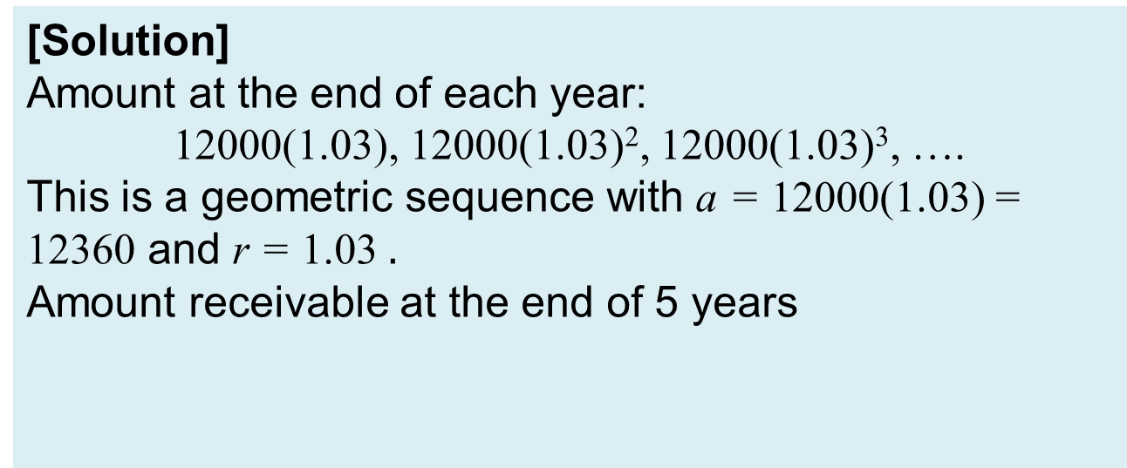
Application (CL)
[Example] Adam sets aside $12,000 and puts it in a bank as a fixed deposit which gives 3% interest per annum. If Adam does not take out the interest and keeps both the original amount and the subsequent interests in his bank account, what would be the amount he would receive at the end of 5 years?
[Solution]
Amount at the end of each year:
12000(1.03), 12000(1.03)², 12000(1.03)³, ….
This is a geometric sequence with a = 12000(1.03) = 12360 and r = 1.03 $.$
Amount receivable at the end of 5 years

Slide 37
Application (CL)
[Example] A factory owner repays his interest-free loan of $2,088,000 from a friend by paying $20,000 for the first monthly instalment, and then increasing the payment by $1,000 in every instalment. After how many instalments will he be able to completely pay off his loan?
[Solution]
The monthly instalments form an arithmetic sequence:
20000, 21000, 22000, …,T_{n}
Thus, let a = 20000 and d = 1000.
We need to find out the number of instalments n, such that S_{n} = 2088000.
Here, we don’t use
because T_{n} is unknown.

Slide 38
Application (CL)
[Solution]
He will completely pay off his loan after 48 instalments.
Quadratic Formula
Given

Slide 39
One-minute write
Please stop what you are doing and produce a written response to either of the following in only one minute:
Identify what is the key learning concepts from the seminar, or
Write down a question with respect to the concepts learnt so far.

Slide 40
Learning Objectives
Identify the characteristics of arithmetic and geometric sequences
Determine the n^{th} term and the sum of first n terms of an arithmetic sequence
Determine the n^{th} term and the sum of first n terms of a geometric sequence
For |r| < 1, determine the sum to infinity of an infinite geometric sequence
Solve application problems involving arithmetic and geometric sequences (CL)

